Slide 1
Nuclear Fuel Performance
NE-533
Spring 2022

Slide 2
Last Time
MOOSE Overview
Fuel pellets change shape due to
Thermal expansion (increase in volume)
Densification (decrease in volume)
Swelling (increase in volume)
Creep (volume stays the same)
The fuel thermal conductivity decreases with burnup
Empirical models take into account both phonon and electron based thermal transport
BISON primarily utilizes the NFIR model to describe thermal conductivity

Slide 3
Zirconium Cladding

Slide 4
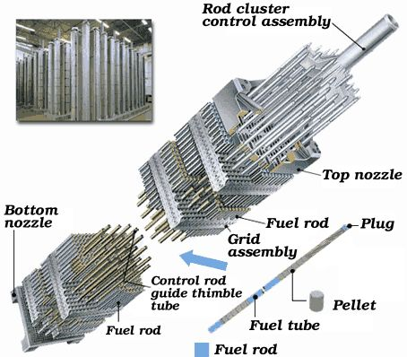
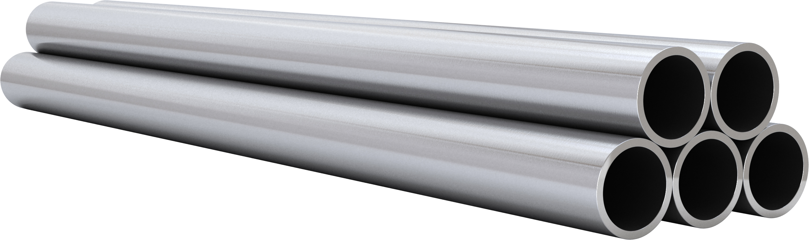
Cladding
The purpose of the cladding is to:
Hold the pellets together so that coolant can freely flow past
Transport heat from fuel to the coolant
Contain fission products
Contain fuel fragments
We would also prefer if the cladding had little to no impact on the neutron transport in the reactor

Slide 5
Why Zirconium alloys?
Benefits
Low neutron cross section
Corrosion resistance in 300˚C water
Resistance to void swelling
Adequate mechanical properties
Good thermal conductivity
Affordable cost
Available in large quantities
Problems?
Corrosion under high temperature steam
Hydride embrittlement
Anisotropic characteristics lead to creep and growth

Slide 6
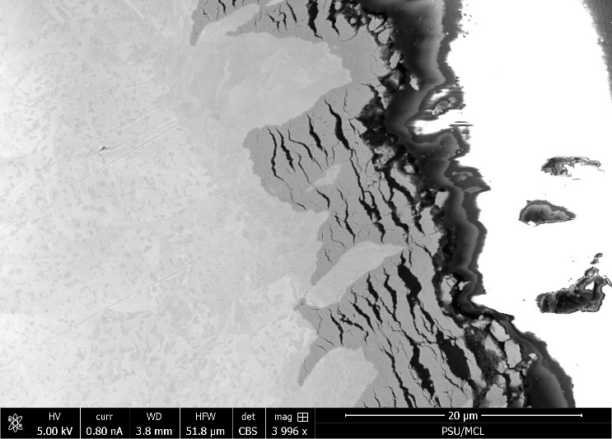
Zirconium
Pure zirconium was not acceptable due to its oxidation behavior
Oxygen with water reacted to form an oxide layer
The oxide layer is brittle and flakes off, allowing more oxidation to occur
Zr alloys were developed to reduce corrosion resistance

Slide 7
Commercial Zr Alloys in PWRs
Alloy | Sn % | Nb % | Fe % | Cr % | Ni % | O %
PWRs (structural components and fuel rods)
Zircaloy-4 (SRA) | 1.2-1.7 | - | 0.18-0.24 | 0.07-0.13 | - | 0.1-0.14
ZIRLO (SRA) | 1 | 1 | 0.1 | - | - | 0.12
Optimized ZIRLO (pRXA) | 0.7 | 1 | 0.1 | - | - | 0.12
M5 (RXA) | - | 0.8-1.2 | 0.015-0.06 | - | - | 0.09-0.12
HPA-45 (SRA/RXA) | 0.6 | - | Fe+V | - | - | 0.12
NDA (SRA) | 1 | 0.1 | 0.3 | 0.2 |  | 0.12
MDA (SRA) | 0.8 | 0.5 | 0.2 | 0.1 |  | 0.12
PRXA Partial Recrystallization Anneal
RXA Recrystallization Anneal
SRA Stress-Relief Anneal

Slide 8
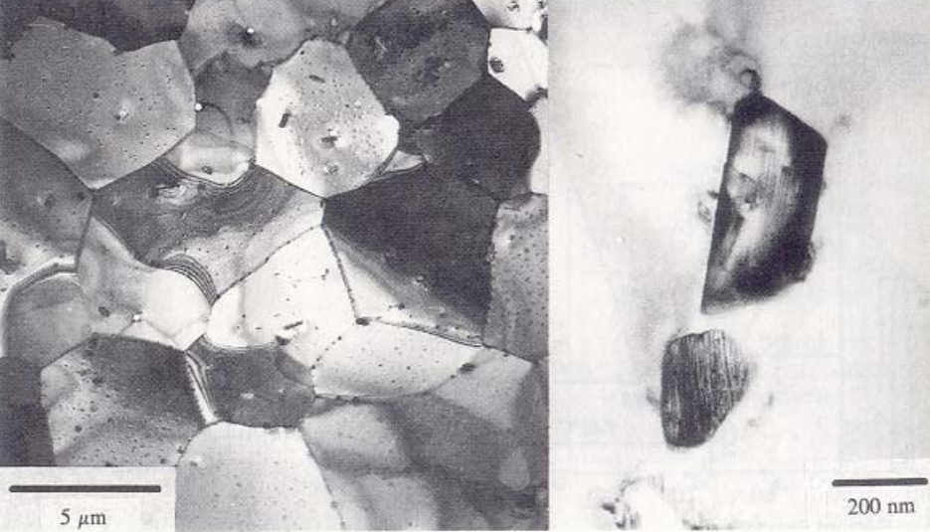
Alloying Elements
The alloying elements impact the microstructure of the material
The intermetallic precipitates significantly improve the oxidation behavior
In Zircaloy 2, the precipitates are
Zr(Cr, Fe)₂
Zr₂(Ni, Fe)
In Zircaloy 4, the precipitates are
Zr(Cr, Fe)₂
Phosphides (Zr₃P) and silicides (Zr₃Si) are also occasionally found
The precipitate distribution, size, morphology, and composition all impact the properties of the material

Slide 9
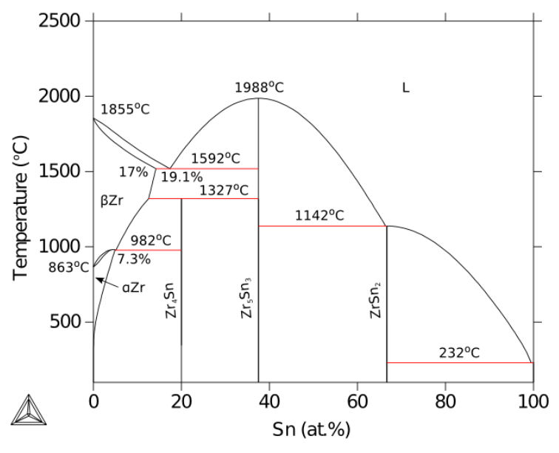
Zirconium Phases
The α-Zr phase has a hexagonal-close-packed (HCP) structure
At temperatures below about 863ºC
Has the most desirable properties
The β-Zr phase has a body-centered cubic (BCC) structure
We try to avoid this phase

Slide 10
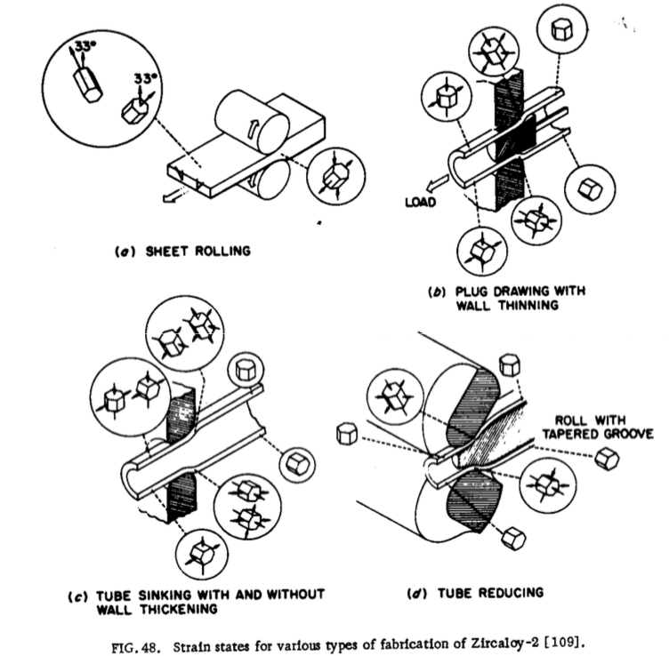
Zr Tube Fabrication
The cladding tubes are fabricated using various processes that SEVERELY deform the material
The severe plastic deformation causes significant dislocation hardening, that can make the tube material too brittle
Plastic deformation along slip planes results in reorientation of the grains
The properties of the material are controlled by heat treatment
Raising the temperature, but below 863˚C, anneals the sample to reduce cold work (stress-relieved)-SRA
Raising the temperature above 863˚C changes to the β phase. They then quench the sample to create a random texture in the α phase-RXA or pRXA

Slide 11
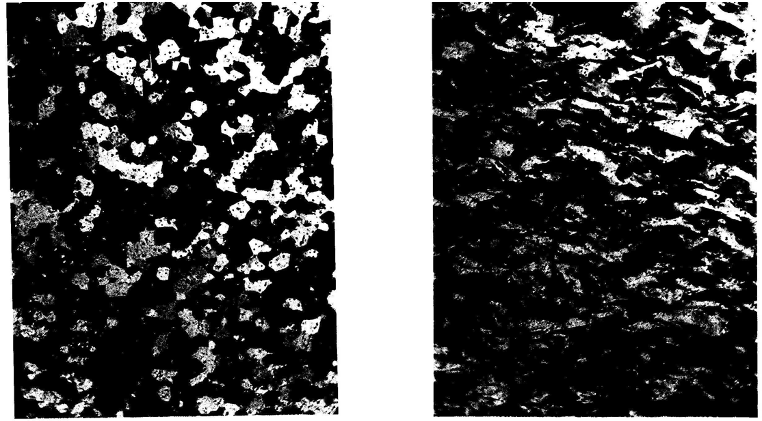
Zr alloy microstructures
Fully recrystallized after quench
Stress-relieved microstructure

Slide 12
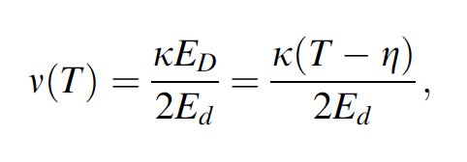
Zirconium Creep and Growth
The cladding undergoes a very large amount of irradiation during its life, the main effects are:
Interstitial loops form on prism planes
Later in the reactor exposure, vacancy loops form on the basal plane
The overall number of displacements to the cladding can be calculated with the NRT model to be ~ 8 x 10⁻⁸ dpa/s, which, over 3 years exposure gives a total of ~8 dpa (every atom in the solid is displaced on the average eight times)

Slide 13
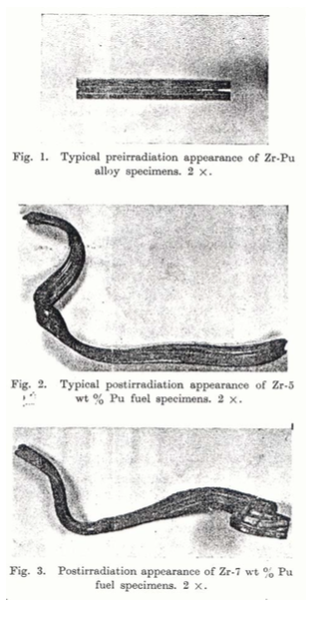
Irradiation Growth
Irradiation growth results from material anisotropy
There must be anisotropy in the defect behavior within the unit cell
There also must be a texture formed in the grain orientations
Interstitial loops form on pyramidal planes, causing shrinkage along the center axis
Later, vacancy loops form on basal planes, making it even worse
The result is a change in shape, shrinking in the 0001 direction and expanding in the pyramidal direction

Slide 14
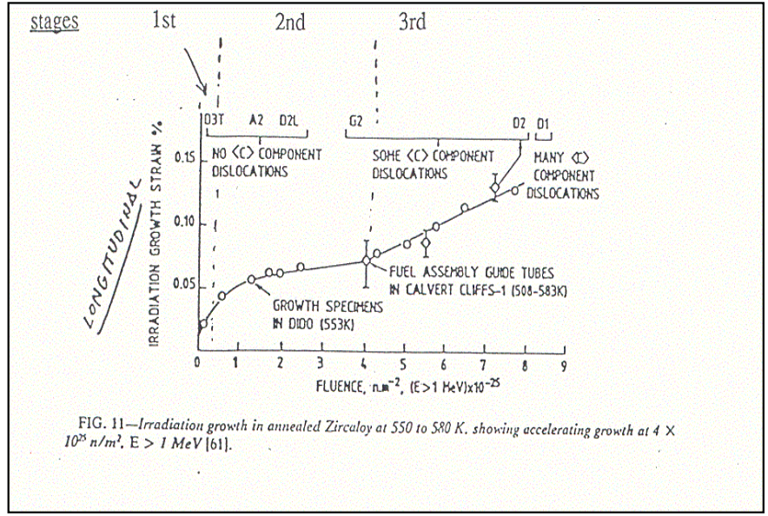
Irradiation Growth
Three stages of irradiation growth
Initial rapid growth to small strains
Slow growth, gets skipped in cold worked material
Accelerated or breakaway growth, caused by formation of vacancy loops on the basal plane
Irradiation growth is affected by:
Fluence, Cold work, Texture, Irradiation temperature, Material chemistry, Hydrogen effects

Slide 15
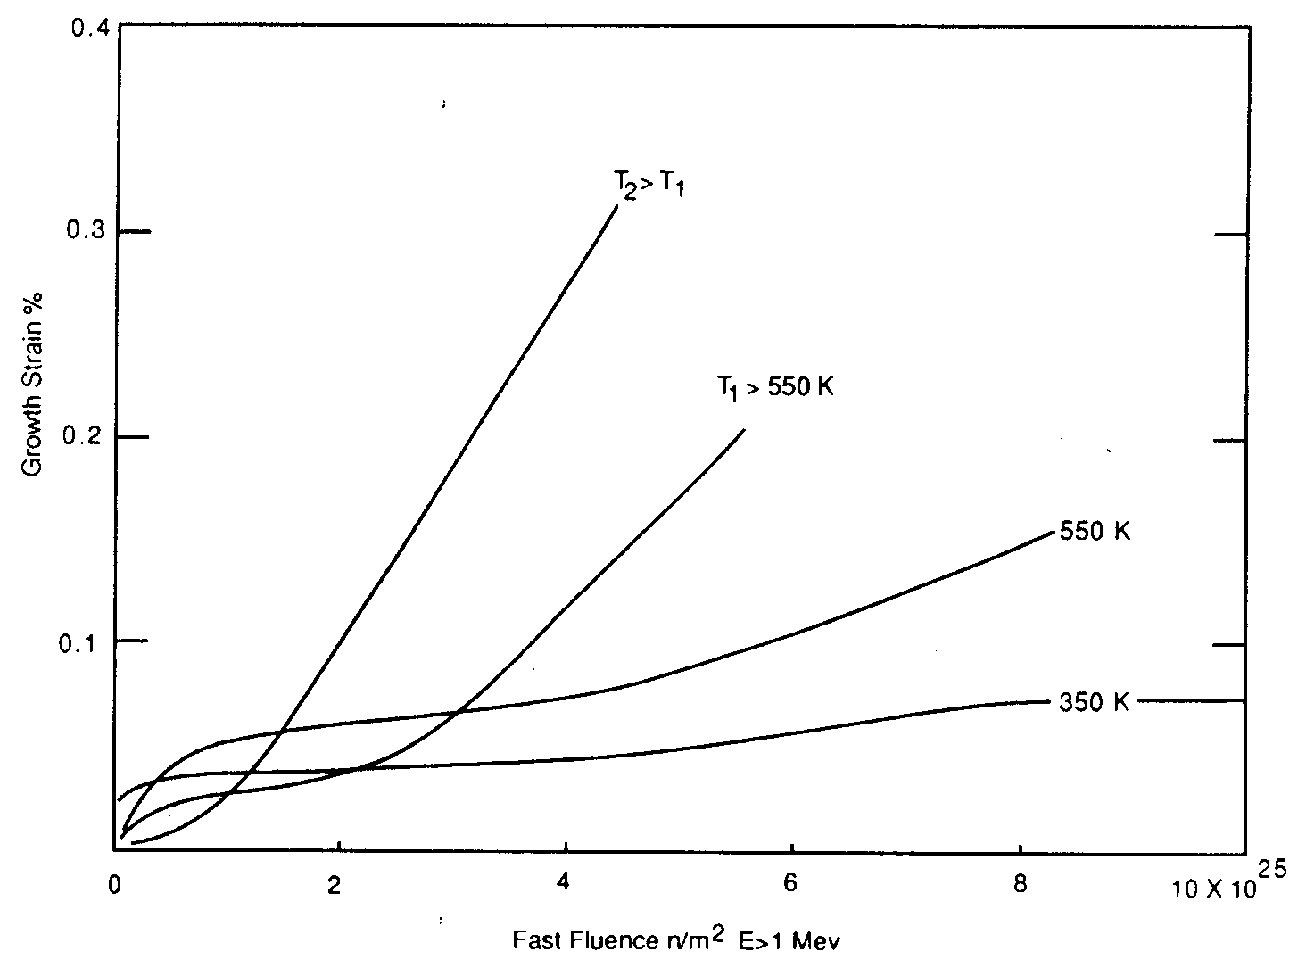
Irradiation Growth
Higher temperature leads to earlier breakaway and higher growth
Higher temperature adds mobility to defects, allowing them to diffuse faster, form clusters, and exacerbate the defect cluster induced anisotropic growth

Slide 16
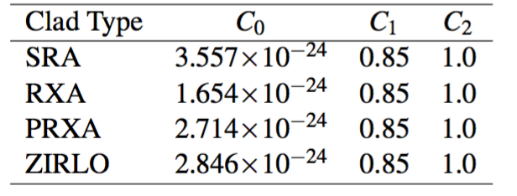
Creep
Empirical models have been developed for thermal and irradiation creep of Zircaloy
Both based on the Von Mises stress
Thermal Creep
With A₀ = 3.14 × 10²⁴ (1/s); shear modulus G = 4.2519 × 10¹⁰ − 2.2185 × 10⁷T Pa; n = 5; Q = 2.7 × 10⁵ J/mol
Irradiation Creep
ϕ is the fast neutron flux n/(cm² s) = 3E11xLHR n/(cm²-s)
Note that SRA stands for stress relief annealed
RXA for recrystallization annealed
PRXA stands for partially recrystallization annealed

Slide 17
Creep Example
Consider an SRA cladding tube at T = 600 K and LHR = 250 W/cm, with a stress σ_{m} = 200 MPa. What is the total creep strain after three years?
First, we will calculate the thermal creep
A₀ = 3.14 × 10²⁴ (1/s)
G = 4.2519 × 10¹⁰ − 2.2185 × 10⁷T Pa = 4.2519e10 − 2.2185e7*600 = 2.92e10 Pa
Q = 2.7 × 10⁵ J/mol, n = 5, R = 8.3144598 J/(K mol)
3.14e24*(200/2.92e4)^5*exp(-2.7e5/(8.3144598*600)) = 1.48e-10 1/s
Now we will calculate the irradiation creep
C₀ = 3.557e-24, C₁ = 0.85, C₂ = 1.0
Φ ≈ 3e11 LHR = 3e11*250 = 7.5e13 n/(cm² s)
3.557e-24*(7.5e13)^0.85*200^1 = 4.43e-10 1/s
The total creep strain rate is 1.48e-10 + 4.43e-10 = 5.91e-10 1/s
The total creep strain after three years is (assuming constant conditions) 5.91e-10*(3600*24*365*3) = 0.056 = 5.6% strain

Slide 18
Creep
Creep impacts fuel performance by shrinking the gap and then conforming to the pellets
a) before “fuel-cladding” interaction; b) start of “fuel-cladding” interaction; c) “fuel-cladding interaction” over most of fuel column
(1)creep down from water pressure; (2)creep out from fuel column; (3)fuel column axial stress

Slide 19
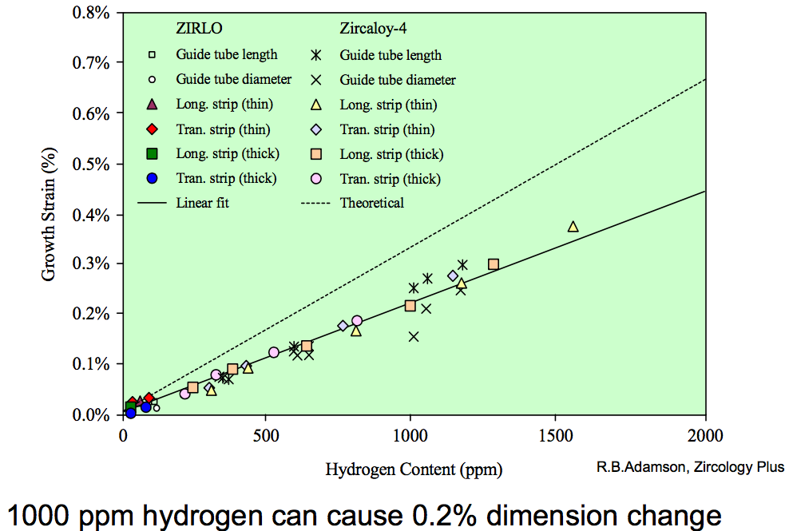
Zirconium Hydrides
Hydrides cause size change because the hydride lattice is larger than the zirconium lattice
There are a number of different Zr-H phases and morphologies that can present
0.1% H can cause 0.2% growth

Slide 20
Summary of Creep and Irradiation Growth
Growth and creep are the major mechanisms for dimensional instability in zirconium alloy cladding
Growth results from the clustering of interstitials on prismatic planes, and eventually from the clustering of vacancies on basal planes such that the material shrinks in the axial direction
Growth depends on the fluence, coldwork, texture, temperature, and composition

Slide 21
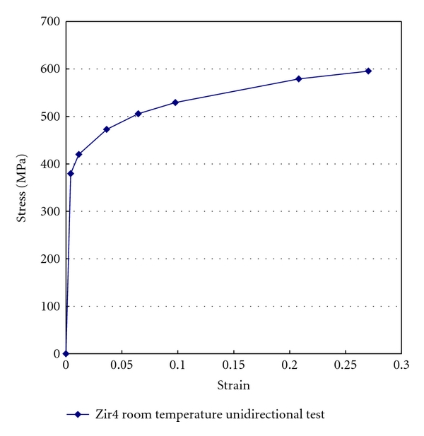
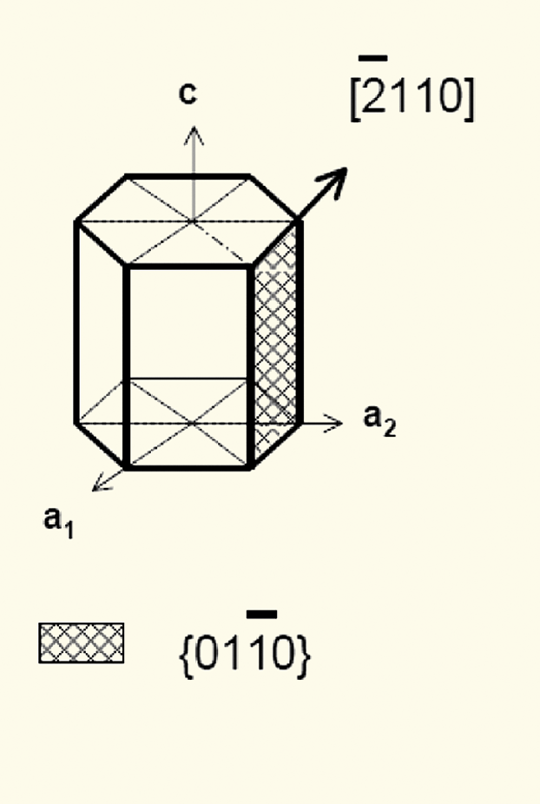
Mechanical Behavior of Zr Cladding
Zirconium alloys plastically deform primarily due to dislocation motion on prismatic planes

Slide 22
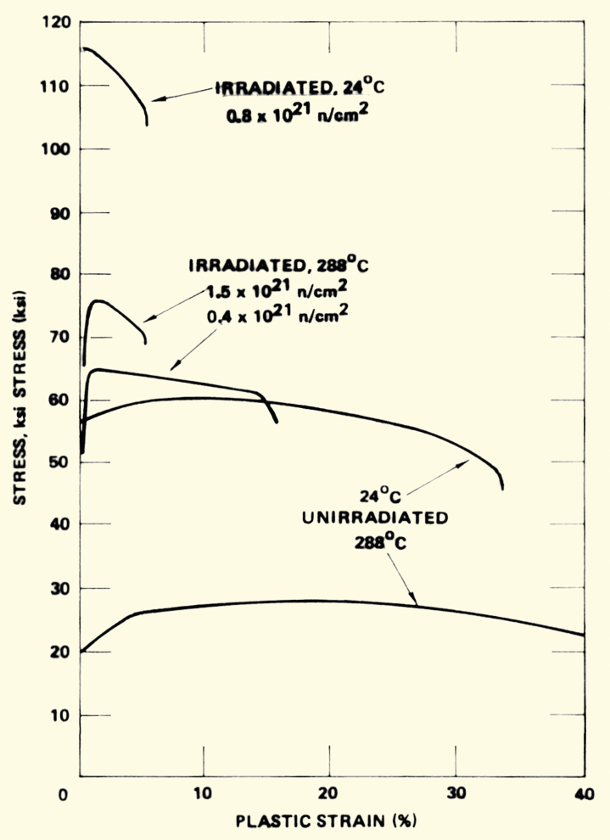
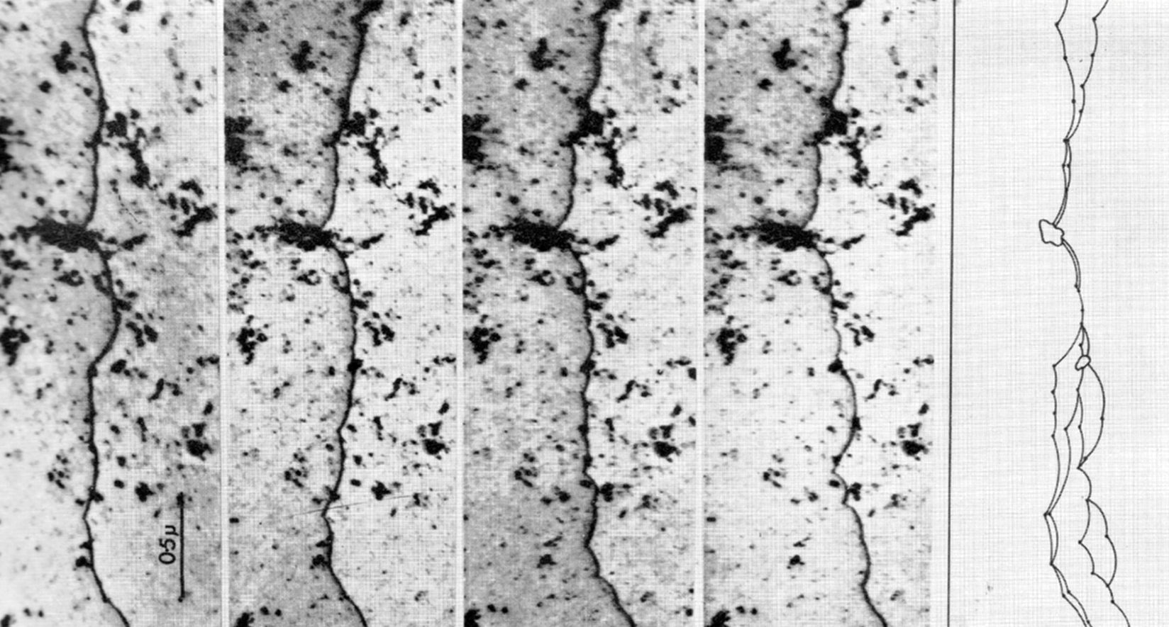
Irradiation Hardening
Under irradiation, the interstitial loops that buildup on the prismatic planes cause hardening
The UTS goes up with fluence, while the strain before fracture goes down
dislocation is moving

Slide 23
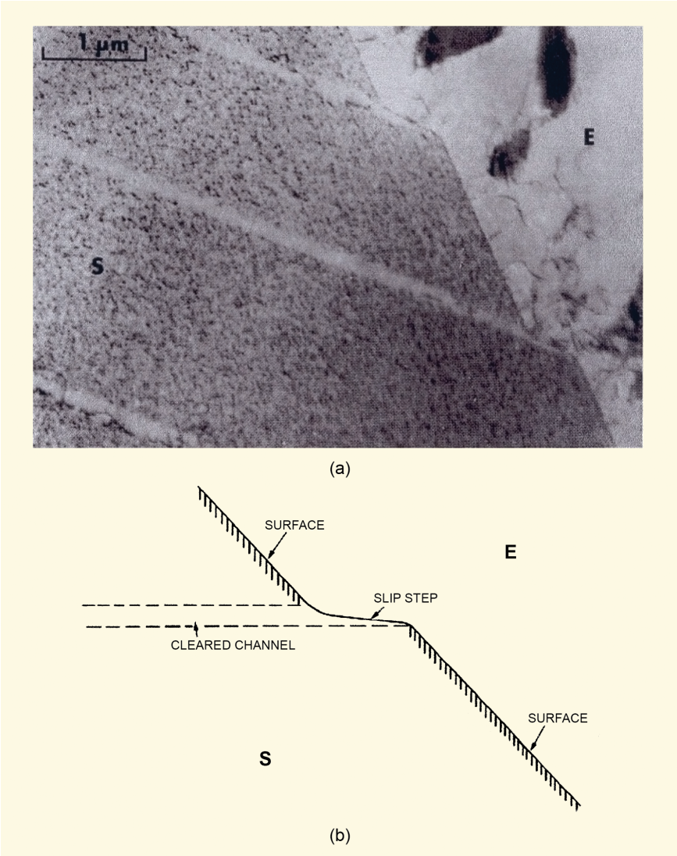
Dislocation Channels
When stress is high enough, loops are “swept away”, forming a clean channel
Once a channel is cleaned out, dislocations continue to move along it
This results in lots of deformation in that one area, creating slip steps
In HCP zircaloy, channels form on basal planes or prism planes depending on
Load direction
Temperature
Oxygen content in the alloy
Fluence

Slide 24
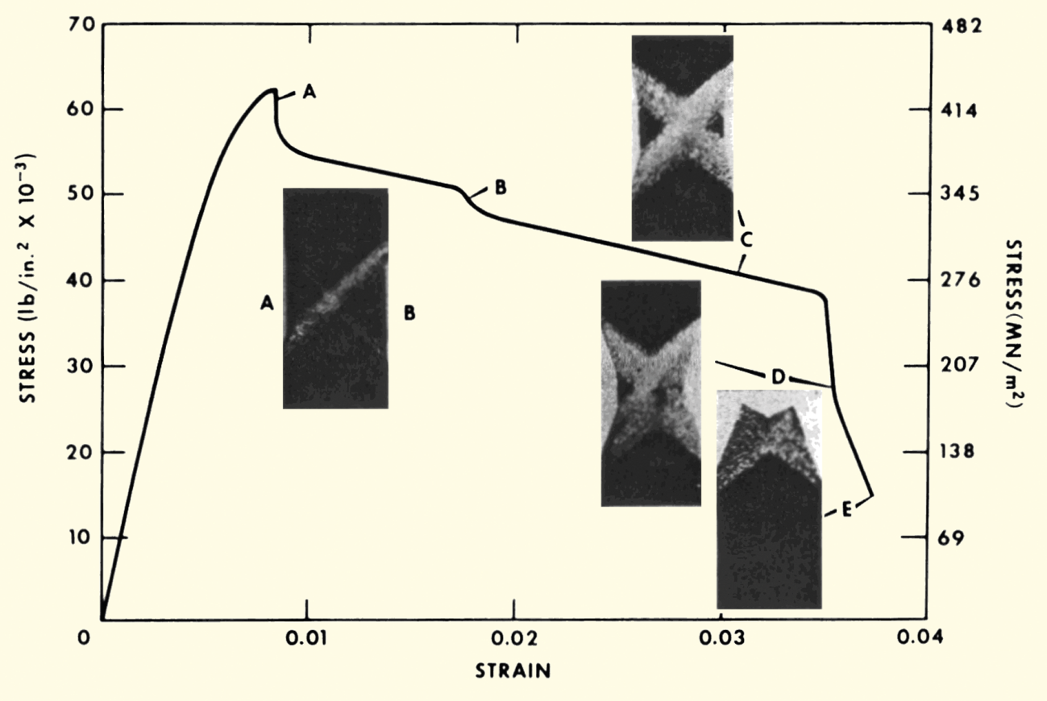
Dislocation Channels
Channel formation is an important behavior in irradiated zircaloy
Dislocation channel deformation occurs at high load or high fluence

Slide 25
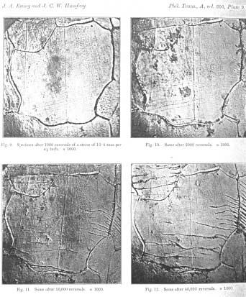
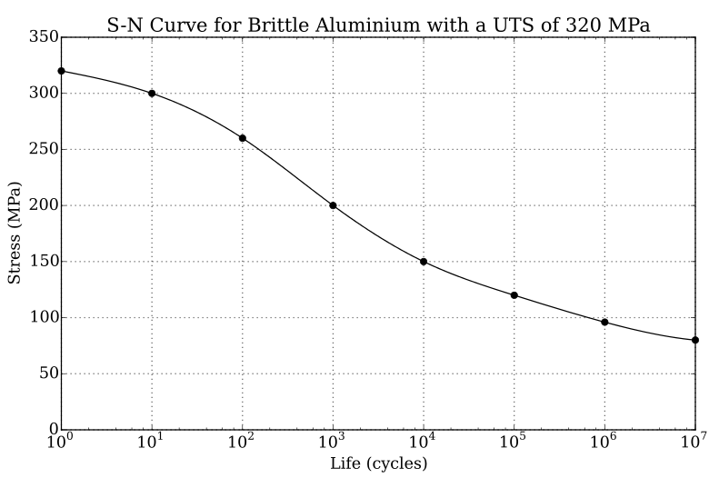
Fatigue
Material fatigue is the weakening of a material caused by repeated applied loads
Materials under cyclic loading can experience brittle like fracture at stresses significantly below their UTS
It is caused by the slow propagation of microstructure damage
The engineering tool for investigating fatigue is the S-N curve
An S-N curve is a graph of the magnitude of the cyclic stress (S) against the logarithmic scale of cycles to failure (N).

Slide 26
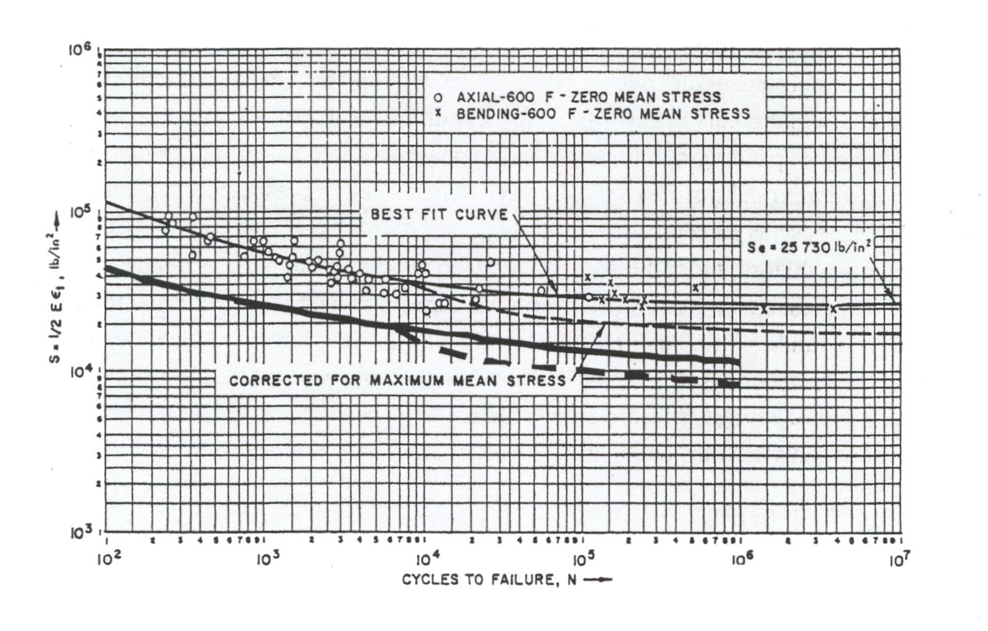
Zr Fatigue
Zircaloy experiences fatigue like other metals
Zircaloy has a fatigue limit at about 10⁵ cycles with 180 Mpa (The UTS is >500 Mpa)
Irradiation slightly lowers the fatigue life in the low cycle range, less than about 10⁴ cycles
Irradiation has no effect on the fatigue life on the high cycle range, greater than about 10⁵ cycles
Design must demonstrate a factor of safety of 2 on stress and 20 on cycles

Slide 27
Pellet Cladding Interaction (PCI)
PCI includes both mechanical (PCMI) and chemical interaction (PCCI), often seen in a more general sense FCMI and FCCI
The process of PCI involves the combination of high internal mechanical stress in the cladding and a corrosive environment resulting from the accumulation of volatile fission products in the fuel-clad gap
These conditions may lead to the initiation and propagation of radial cracks, which can penetrate through the cladding
Frequent PCI failures were observed in the 1960s and 1970s, leading to extensive research efforts
Altering operational procedures, modifying the manufacturing process of the cladding, adding a composite layer and/or applying a protective coating to the inner cladding surface can help mitigate these failures

Slide 28
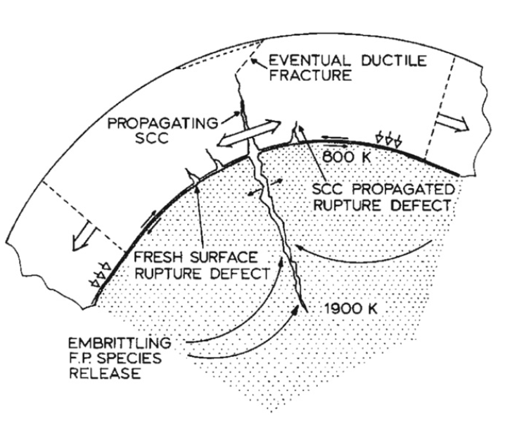
Physical Phenomena in PCI
The fuel thermally expands and swells
The cladding undergoes thermal and irradiation-induced creep
Mechanical interaction between the fuel pellet and cladding generates radial compressive stresses in addition to tensile hoop stresses
Volatile fission product gases are released into the gap
The cracking of the fuel pellet together with non-uniform thermal expansion resulting in preferential contact at the pellet interfaces increases local mechanical stresses in the cladding

Slide 29
Stress Corrosion Cracking (SCC)
Alloys that are in a corrosive environment may develop cracks that would not otherwise develop in the absence of either stress or the corrosive environment – stress corrosion cracking (SCC)
Stress corrosion cracks may propagate along intergranular (IG) and/or transgranular (TG) paths
The propagation modes of these cracks may depend on the localized mechanical and chemical conditions that lead to SCC
In order for SCC to initiate and propagate in any material, four conditions are simultaneously required:
A corrosive environment, a susceptible material, sufficient stress, and sufficient time

Slide 30
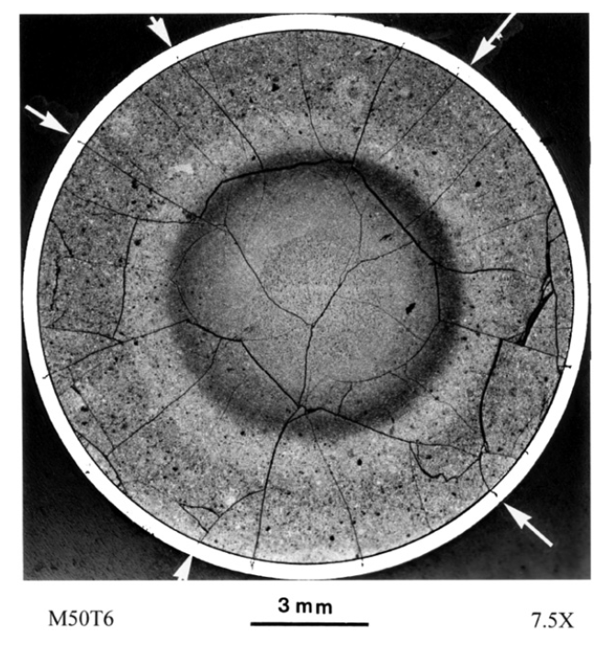
Corrosive Environment
Chemically aggressive fission products accumulating in the fuel-clad gap form an important component of the corrosive environment
Primary corrosive species are the volatile fission products, such as iodine (I), cadmium (Cd) and cesium (Cs)
Corrosive species can diffuse down the temperature gradient through fuel cracks
A higher local concentration of fission gases exists near the fuel crack and SCC is more likely to occur in the adjacent cladding region

Slide 31
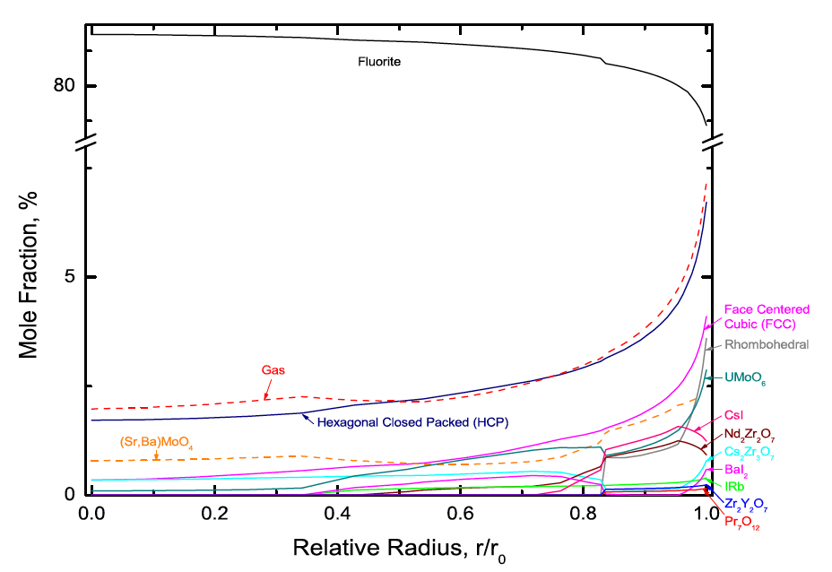
Corrosive Environment
The ability of fission product atoms to be transported through the fuel to the fuel-clad gap depends on several factors, including its physical state
The mobility of fission gases is markedly different than solid state diffusion
The relative amounts of I and other chemical elements in the gaseous phase depend on the local fuel chemistry, which varies spatially
The figure illustrates the predicted effects of fuel chemistry, in particular the predicted spatial distribution of phases in highly irradiated PWR UO2 fuel, whereby the chemical behavior on the fuel surface is of particular interest

Slide 32
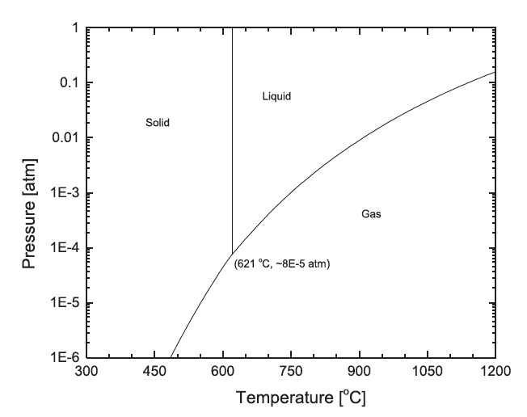
Corrosive Environment
CsI
The dominant I containing solid phase that is predicted to be thermodynamically stable on the fuel surface is CsI
Since typical fuel surface temperatures during normal operating conditions are of the order of 350–450 C and the hydrostatic pressure is greater than 1 atm, one would expect that solid CsI would be stable in the fuel-clad gap
The radiolytic decomposition of CsI increases the iodine partial pressure in the gap by many orders of magnitude

Slide 33
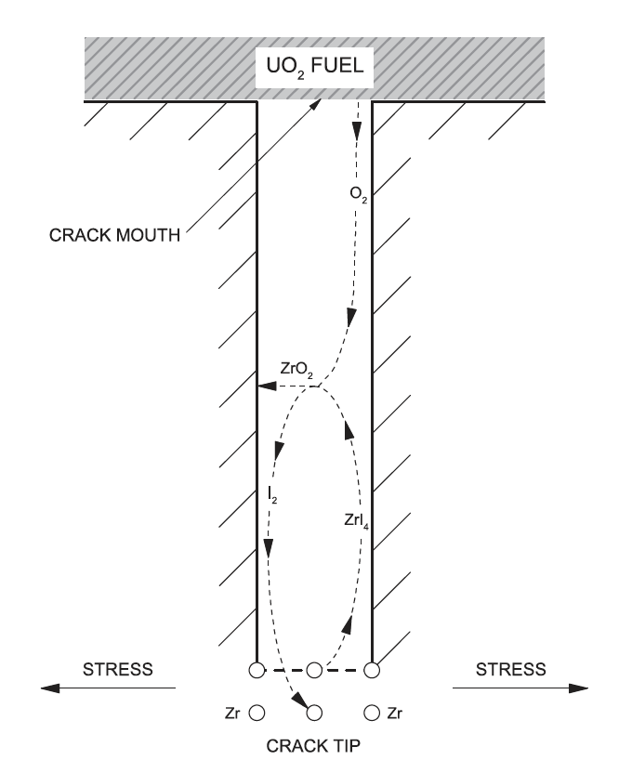
Corrosive Environment
The chemical interaction of liberated I (and possibly other elements) with the cladding is of great importance in crack initiation
A zirconium iodide gaseous species migrates up the temperature gradient towards the crack mouth, whereby the high affinity of Zr for O may result in ZrO2 formation, and decomposition may once again liberate I2 gas
The deposition of ZrO2 on the crack walls is believed to create a passivation layer, which further localizes I encroachment at the crack tip

Slide 34
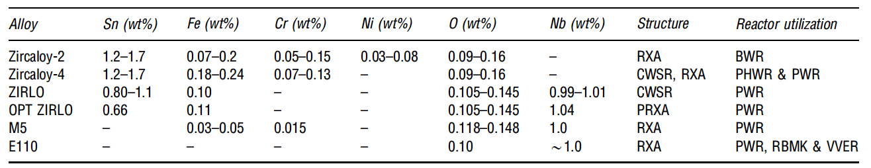
Susceptible Material
The susceptibility of the cladding to SCC can be influenced by many factors, including the composition, microstructure, texture, and irradiation damage of the cladding, and the presence of an oxide passivation layer, which protects the metal from chemical attack
All zirconium alloy cladding materials used in commercial power reactors are prone to PCI failure
Minor compositional changes have been shown to offer slightly different performance characteristics

Slide 35
Susceptible Material
The initial motivation of alloying zirconium with small amounts of tin was to offset the loss of corrosion resistance resulting from the introduction of nitrogen impurities during fabrication
The control of impurities during manufacturing have significantly improved since the introduction of these alloys, making the addition of unnecessary
The addition of niobium to these zirconium alloys increases the strength of the cladding while providing higher irradiation creep resistance and has exhibited elevated corrosion resistance, which is desirable for higher burnup fuel
All Zr alloys are somewhat equally susceptible to SCC cracking following prolonged irradiation

Slide 36
Sufficient Stress
The stress on the cladding depends on the external coolant pressure and creep, in addition to the stress imposed internally by the fuel, which is primarily due to thermal expansion and fission product swelling

Slide 37
Sufficient Time
The timeframe in which this process occurs depends on fuel cycle lifetimes, refueling and irradiation history

Slide 38
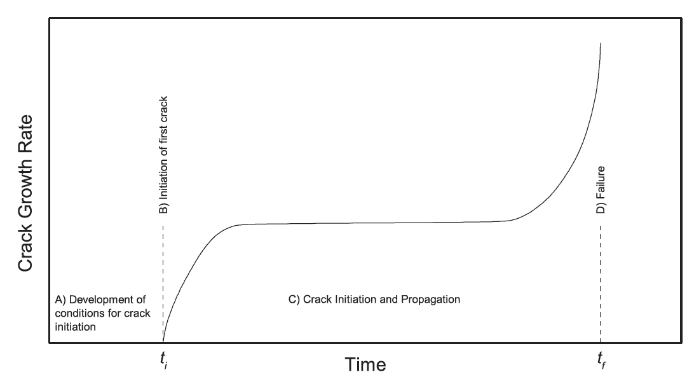
SCC Stages
The SCC process can be divided into four stages:
Development of the corrosive environment and the surface conditions required for SCC to initiate,
Initiation of SCC,
Propagation of SCC, and
Failure
The SCC-induced crack will typically propagate through the majority of the cladding wall, and then the remaining ligament typically fails by ductile shear

Slide 39
Summary
Under irradiation, zirconium experiences irradiation induced hardening due to interstitial loops on the prismatic planes
Channels form that don’t have loops, resulting in localized deformation
Fatigue can be an issue for cladding, limiting reactor lifetime
Pellet-clad interaction (PCI) takes two forms
Pellet-clad chemical interaction, PCCI (bonding occurs)
Pellet-clad mechanical interaction, PCMI (pellet pushes and drags cladding)

Slide 40
EXTRA

Slide 41
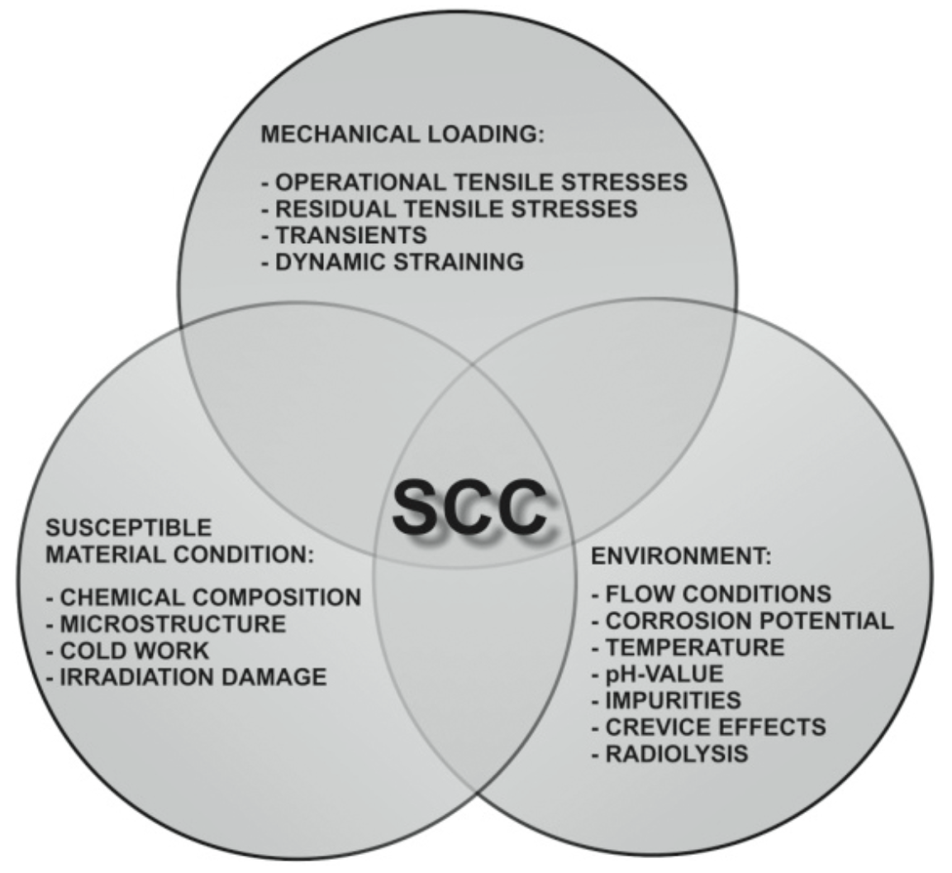
Stress Corrosion Cracking (SCC)
SCC occurs when environmental effects accelerate fracture
Zirconium alloy tubes do not react (much) with water, but have SCC from fission products inside tube
Early studies identified iodine as a primary SCC agent
Later, Cd identified as potent liquid metal embrittling agent

Slide 42
Fuel-Clad Chemical Interaction (FCCI)
One possible issue with the fuel is fuel and cladding bonding
Bonding tends to occur with pellet-clad contact at high burnup and high power (pellet-clad chemical interaction or PCCI)
Bonding results from the inter diffusion of U-Zr-O
Bonds can also involve cesium in uranates and zirconates
Bonding eliminates gas gap between pellets and cladding
Improves heat transfer
Bonding connects pellets and cladding
Increases PCMI

Slide 43
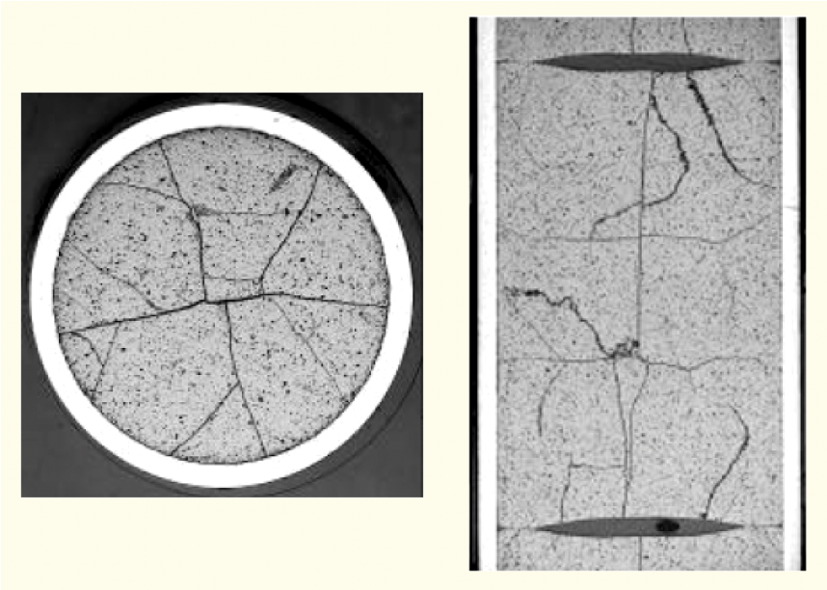
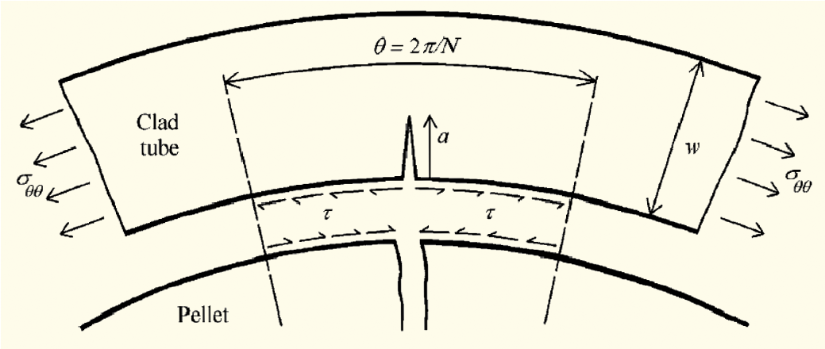
Fuel-Clad Mechanical Interaction (FCMI)
Also referred to as Pellet-Clad mechanical interaction (PCMI)
Mechanical loading arises from interaction among pellet fragments and interaction of fragments with cladding
Mechanical interaction involves friction or bonding at pellet-clad interface
Differential thermal expansion, swelling and creep lead to contact forces in radial direction
Friction or bonding convert differential strains into circumferential and axial forces
[Brochard et al, 2001]

